Slide 1
Star Streams: Smooth or Lumpy?
Ray Carlberg & PAndAS
(Wayne Ngan simulations)

Slide 2
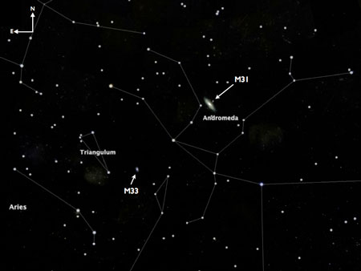

Slide 3
Cosmology focus changed
Many parameters of the universe known to 2-3 digits
  “just six numbers”
  Two Dark numbers
What is the physics of this stuff?
Why?

Slide 4
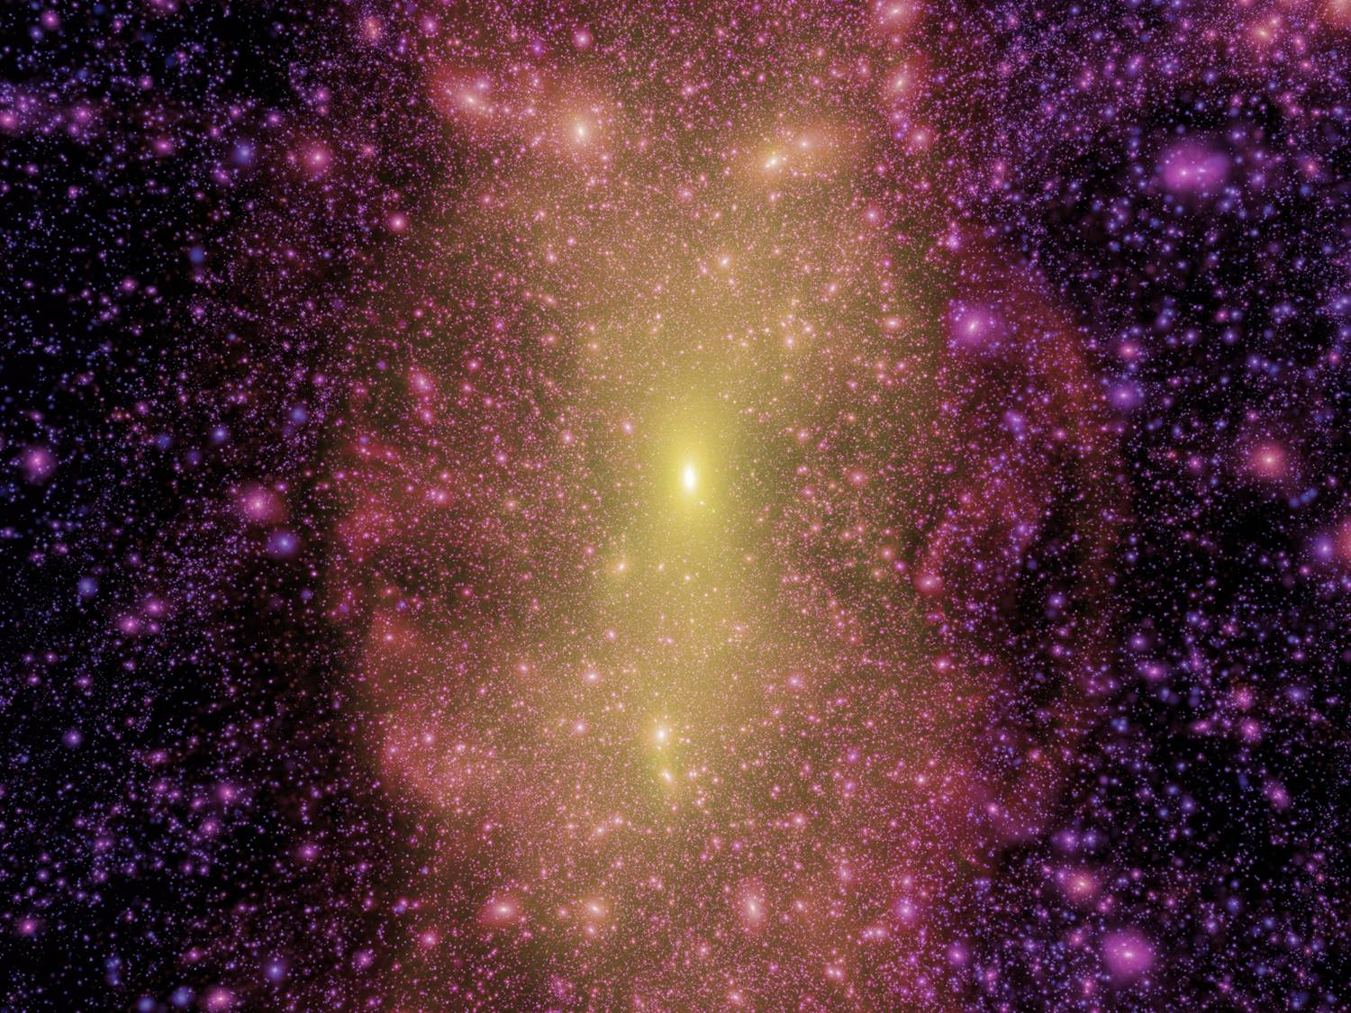
N-body CDM dark matter simulation: 10’s of 1000’s of halos

Slide 5
CDM Halos ~10% mass in sub-halos
Tidal streams cannot remain smooth in CDM
  Folded,
  chopped,
  heated
Are observed streams smooth or lumpy?
Complications:
    foregrounds,
    small N stats
    Stream Age
    Other dynamics

Slide 6
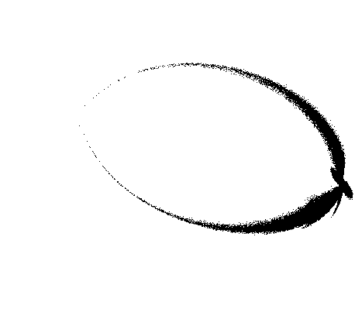
smooth

Slide 7
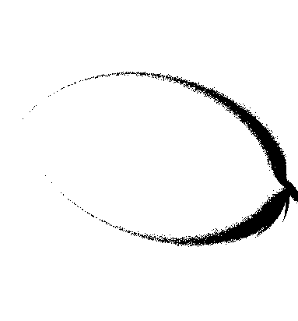
5 sub-halos

Slide 8
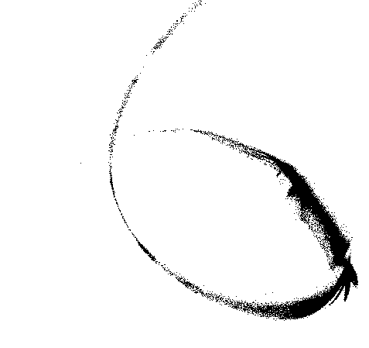
100 sub-halos

Slide 9
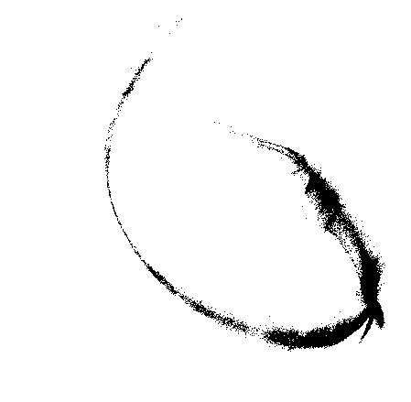
One thousand sub-halos

Slide 10

Pan Andromeda Archaeological Survey
400 square degrees of M31-M33
Extends out 150 kpc from M31
CFHT Megaprime g and i band images
i~24.5mag limit
Color-mag matched to old RGB isochrones
  Gives [Fe/H]
  For roughly 4 million stars
  Limit ~34 mag/sq arcsec

Slide 11
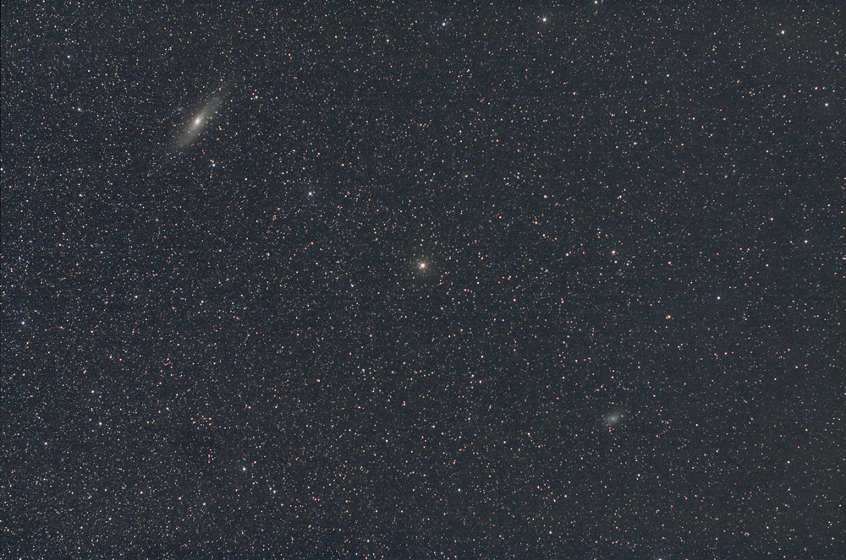

Slide 12
AndXXVII

Slide 13
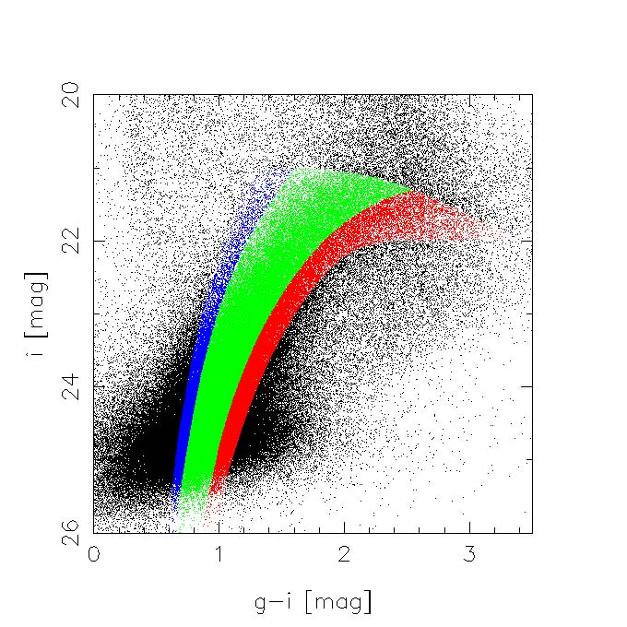

Slide 14
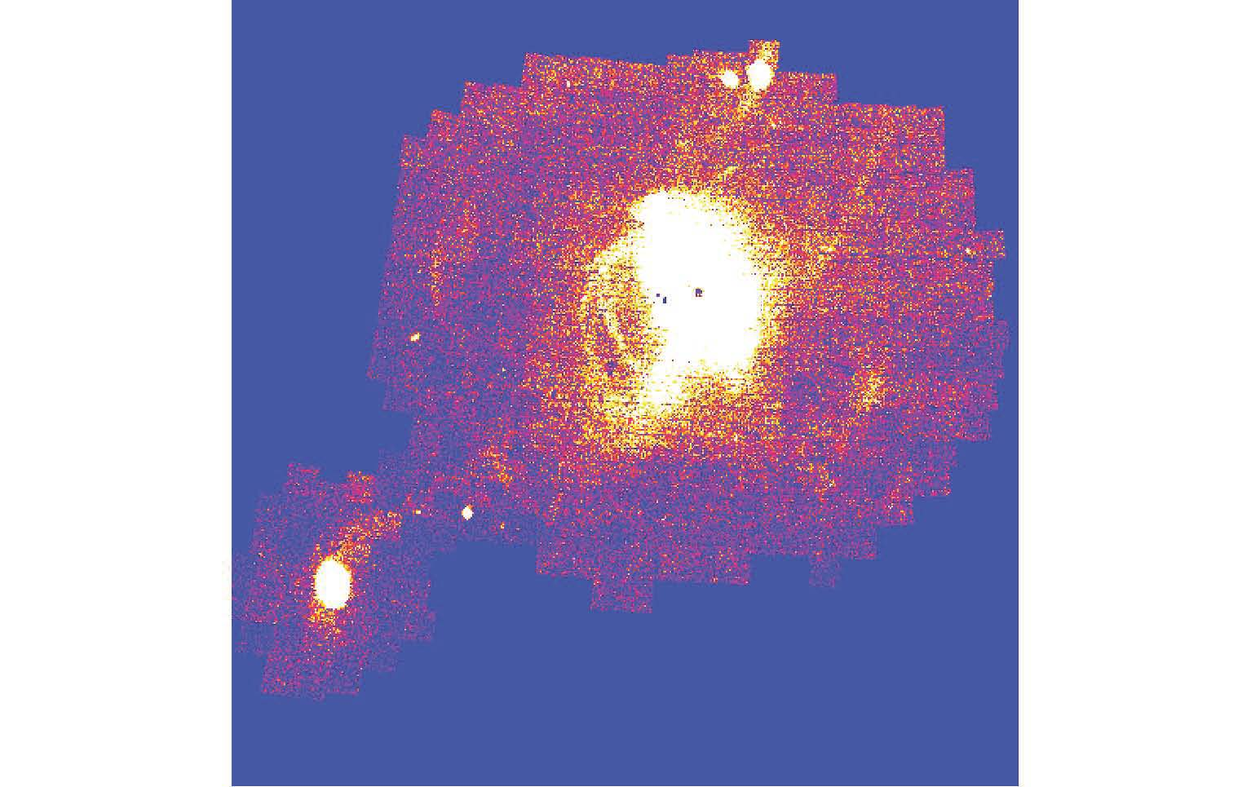
NW Stream

Slide 15
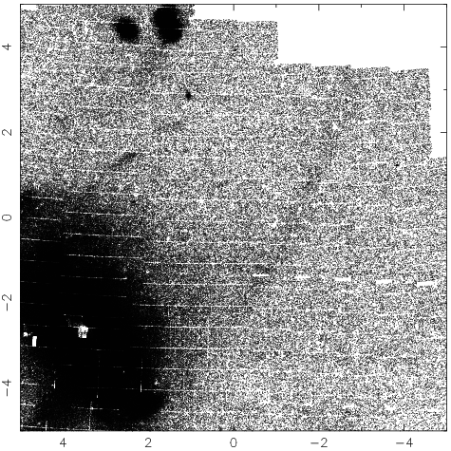

Slide 17
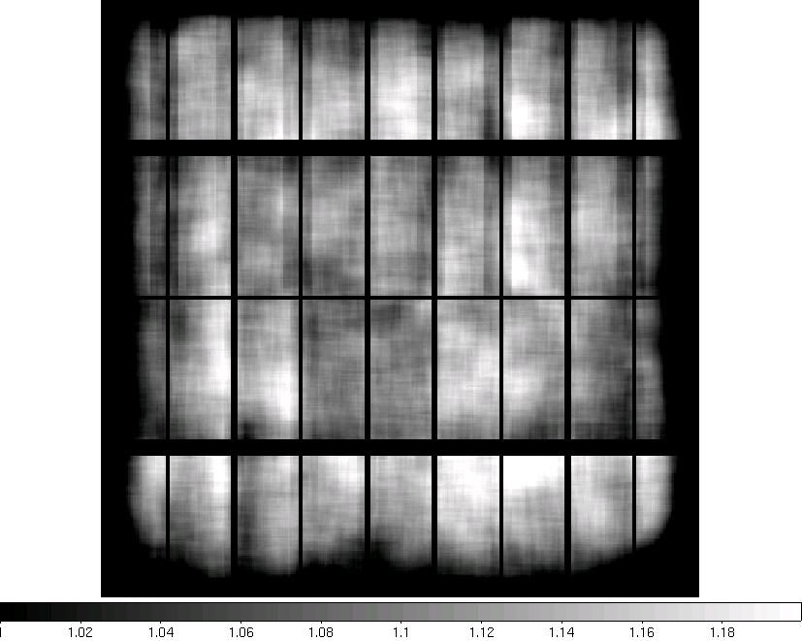
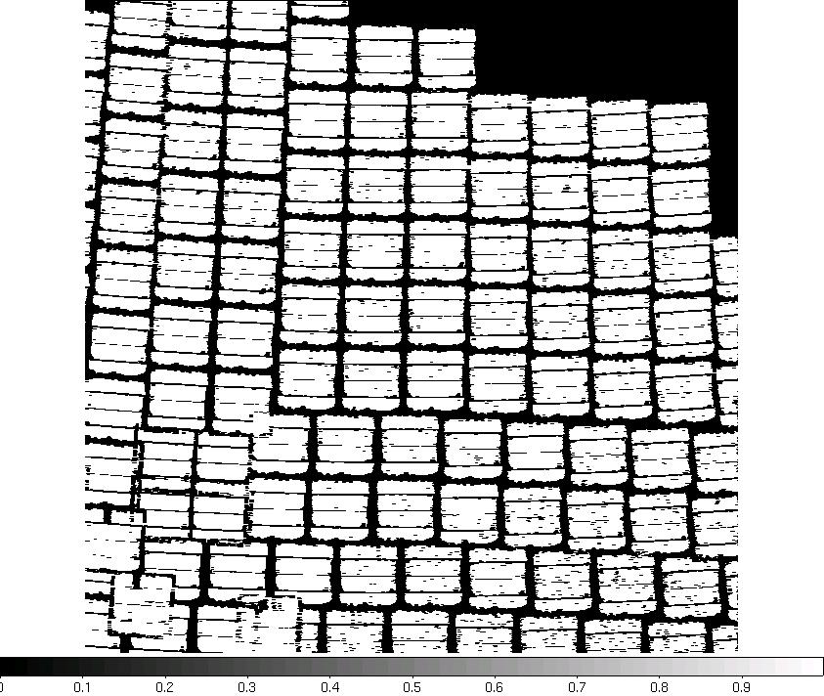
Non-uniform photometric coverage

Slide 18
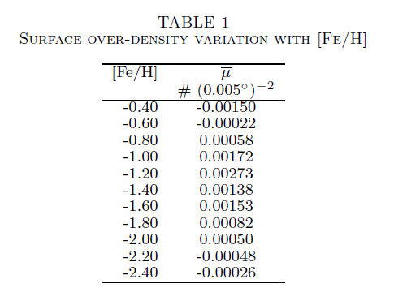

Slide 19
Stream width
2.5 kpc

Slide 20
Density in Stream

Slide 22
No stream at high metal abundance

Slide 23
Statistical Significance of Lumps
Stream is a 15% overdensity
  Stats dominated by background fluctuations
χ ² / ν indicates >99.9999% confidence that fluctuations are in excess of noise for 1, 2, 4 and 8 degree binning (scales 3-20 kpc).

Slide 24
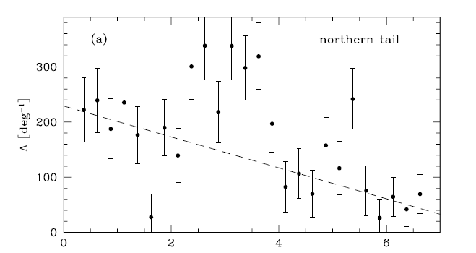
Other lumpy/non-lumpy streams
Pal 5: Oddenkirchen et al. one lump in 4kpc long segment
Sgr: Majewski et al. find such small velocity deviations that assert that the MW halo must be smooth. Possibly, but velocities are culled to remove outliers that may be part of stream.

Slide 25
Discussion
Stream is lumpy => halo cannot be smooth
  Density 0-3x mean
  Scales 3-20 kpc
  Statistical significance >99.999% confidence
Dark matter cannot be smooth
What causes the lumpiness?
  Jeans instabilities [wavelength too long]
  Resonant ejection ? Not in n-body
  Epicyclic orbit pileup ? [wavelengths too long]
  Dark matter sub-halos: seems likely
  LUMPY CDM halo consistent

